Slide 1
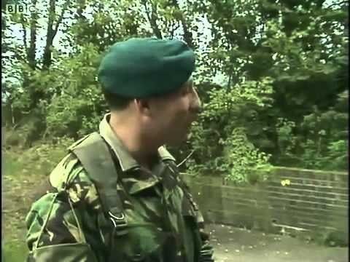

How to make a Royal Marines Officer Part I

Slide 2

How to make a Royal Marines Officer Part 2

